Slide 1

Title of the Project:
Analyzing the districts of Delhi where crimes are frequently occurring and using that analysis to make a place safer.

Slide 2









Iqra Akhlaq
Adiba Khan
Team Number 63
Afshan Fatima
Mohd Faizan Saifi
Jamia Millia Islamia
MSc Mathematics with Computer Science
Omar Hussain Khan
Mohammad Zaid Nadeem
Poorvi Vashistha
Komal Sharma

Slide 3

Project Summary:
This Project analyses 5 broad categories of crimes occurring frequently around the districts of Delhi City and uses that analysis to reach to some crime prone areas where these heinous happenings occur.
At first the 5 broad categories are divided into sub narrow categories and each district is compared for the frequency of a particular crime. Then it is compared with the frequency of crimes occurring in the same districts for the previous 4-5 years. This further empowers us to narrow down the measures and use our forces for the very purpose of curbing that crime in that particular area.

Slide 4

Purpose of the Project:
Delhi, a crime hub of our country, leads other cities in heinous happenings. Looking at this grim picture of our country's capital, this project helps in highlighting those districts which are prone to crime and the comparison of each with its previous years occurring helps us finding the measures that can be helpful for our law enforcement agencies to implement them and make our dwelling city safer to live.

Slide 5

Data Procurement and Data Sources:
https://ncrb.gov.in/sites/default/files/crime_in_india_table_additional_table_chapter_reports/Districtwise%20Crime%20against%20Women_2020.xlsx
https://ncrb.gov.in/crime-in-india-table-contents?field_date_value[value][year]=2020&field_select_additional_table_ti_value=All&items_per_page=All
Crime in India Additional Table Contents | National Crime Records Bureau (ncrb.gov.in)

Slide 6
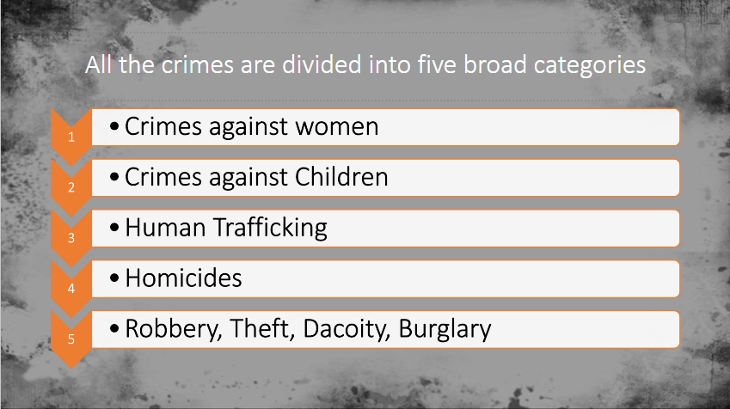
All the crimes are divided into five broad categories
1
  Crimes against women
2
  Crimes against Children
3
  Human Trafficking
4
  Homicides
5
  Robbery, Theft, Dacoity, Burglary

Slide 7
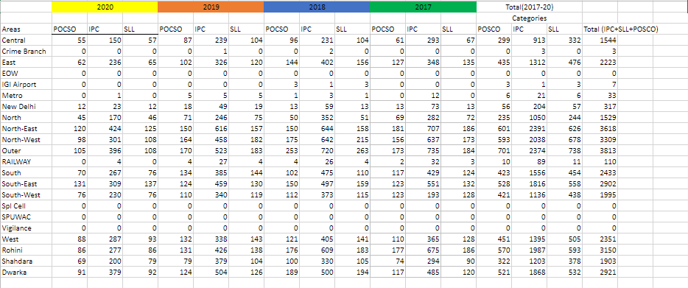
For each category, separate dataset has been prepared
Like this given below.

Slide 8
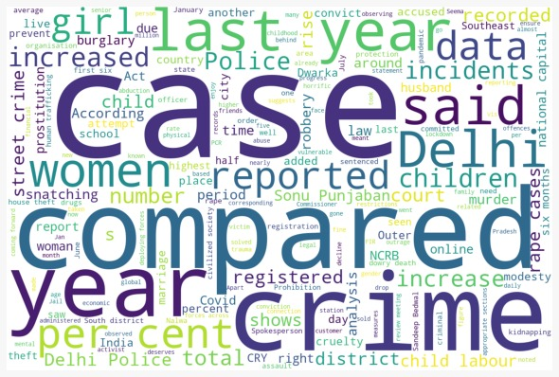
This Word Cloud depicts that our National Capital of India is
the National Crime Capital as well

Slide 9

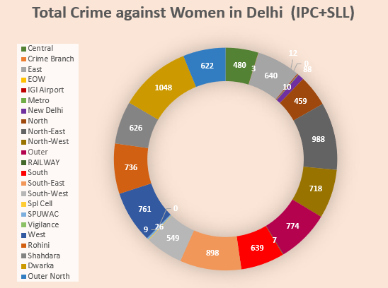
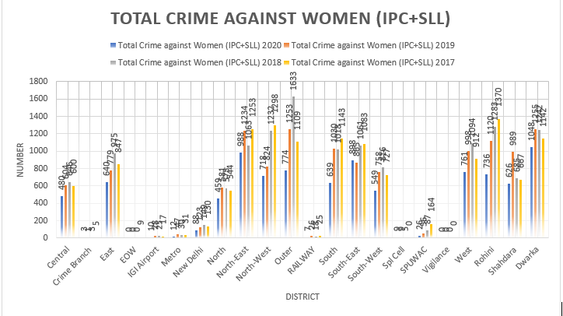
1. Crimes Against Women​
Analyzing all the crimes against women occurring in Delhi, this donut chart shows that North- West district is in lead where the rate is the highest.
This multiple bar graph shows that in last 4 years, the number of crimes against women has decreased, but the outer, North-west, and Rohini districts still needs to improve a lot.

Slide 10

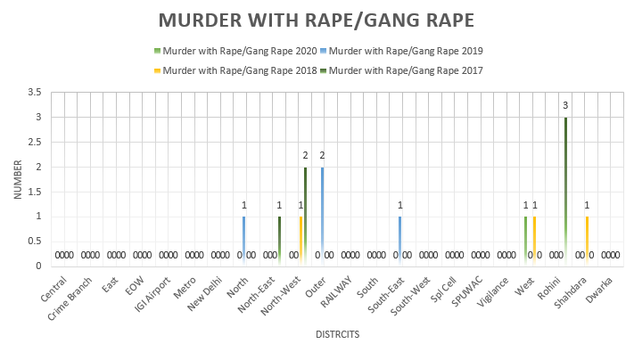
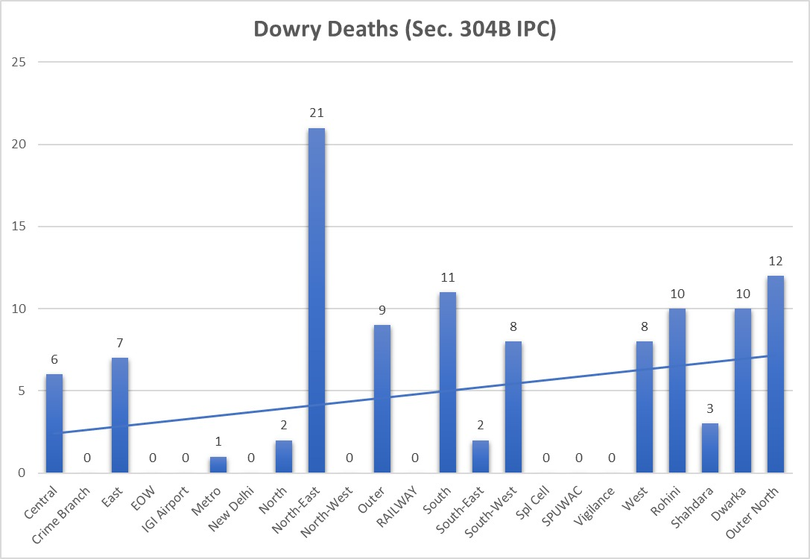
Sub-category- Rape is more frequently seen in the areas of Dwarka, North-east, south-east, central, west and so on with the help of this bar and line graph.
This bar and line graph shows that North-East Delhi play a key role in dowry deaths, and central, east and west districts are not far behind.

Slide 11

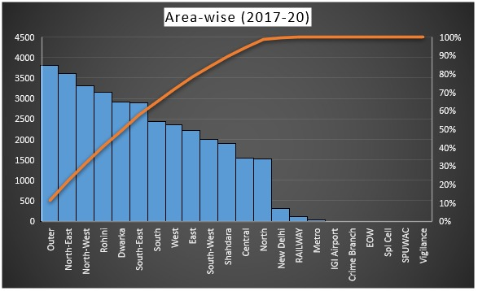
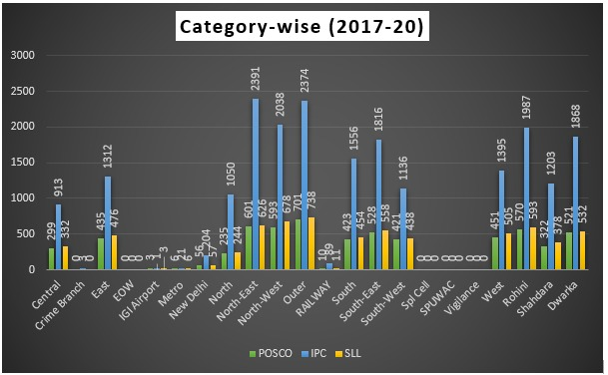
2. Crimes Against Children :
This Bar and line graph depicts the total number of crimes against children happening around the districts of Delhi. .
This triple bar graph clearly depicts that the crimes of IPC category is higher all over Delhi. Also, North-East and outer areas are worst places in terms of children's safety.

Slide 12

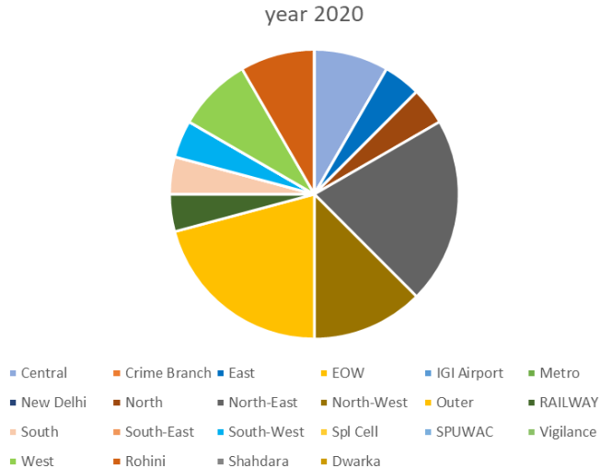
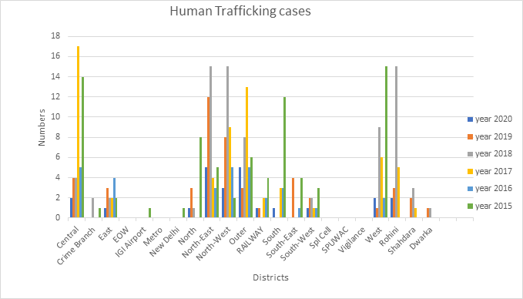
3. Human Trafficking
This Pie Chart is showing Human Trafficking cases in 2020 in different districts of Delhi.
Where, North-East, North-West and areas of West play the major role, while Rohini, New Delhi and Central Delhi follows behind.
Below it, The grouped bar graph shows the human trafficking cases from 2015-2020 occurred in different districts of Delhi.
Which clearly shows that in the past six years Delhi has reduced trafficking humans.

Slide 13
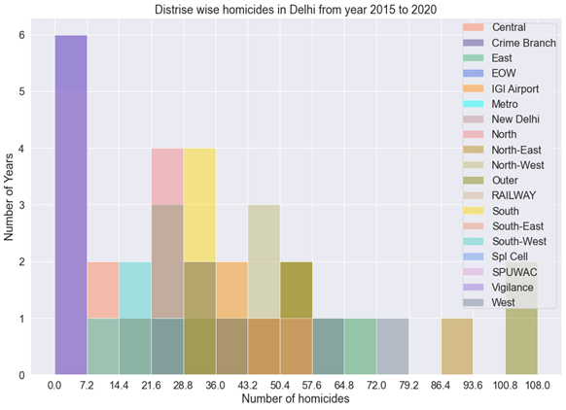
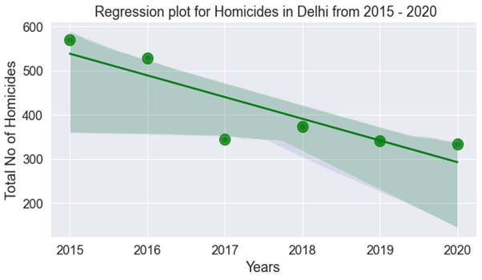
4. Homicides
The Stacked Bar graph in the right shows how different districts of Delhi lying under the cloud of homicides happening round the clock.
While the regression plot in the left shows how in 2020 we have seen a sharp decline of homicides from 2015, yet we have a lot to achieve.

Slide 14
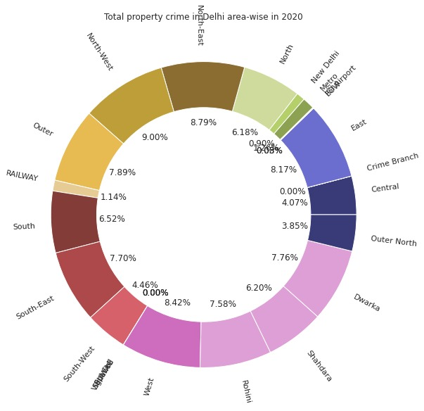
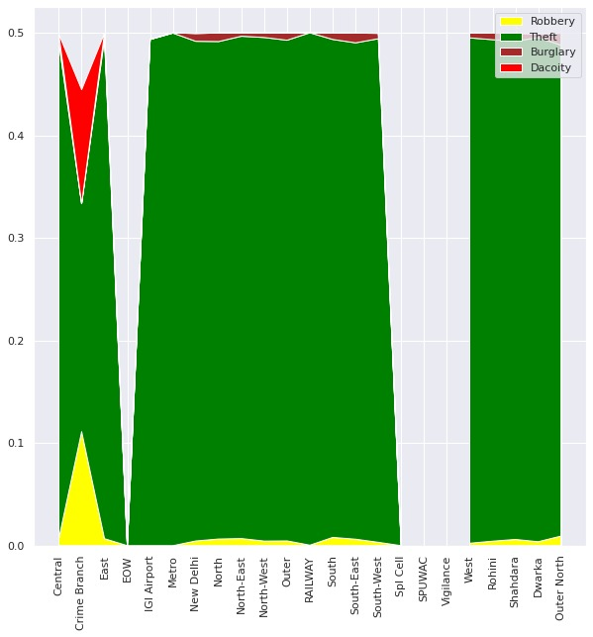
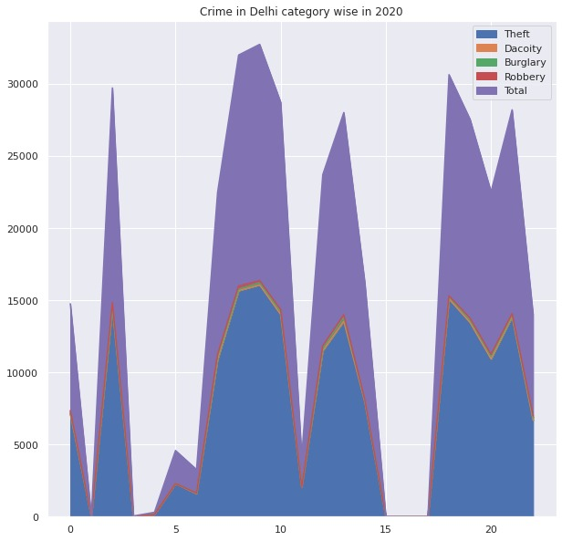
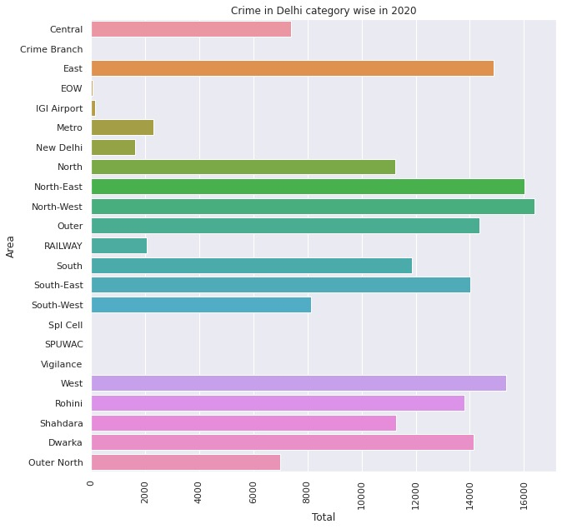
5. Robbery, Theft, Dacoity, Burglary
This is the area plot of the crime in Delhi district-wise in 2020.
This is the area plot of the property crimes in Delhi category-wise in 2020.
This donut chart is showing the total property crimes (Robbery, Theft, Dacoity, Burglary) in 2020 in different areas in Delhi.
This is the bar plot of the total property crimes in 2020 in Delhi.

Slide 15
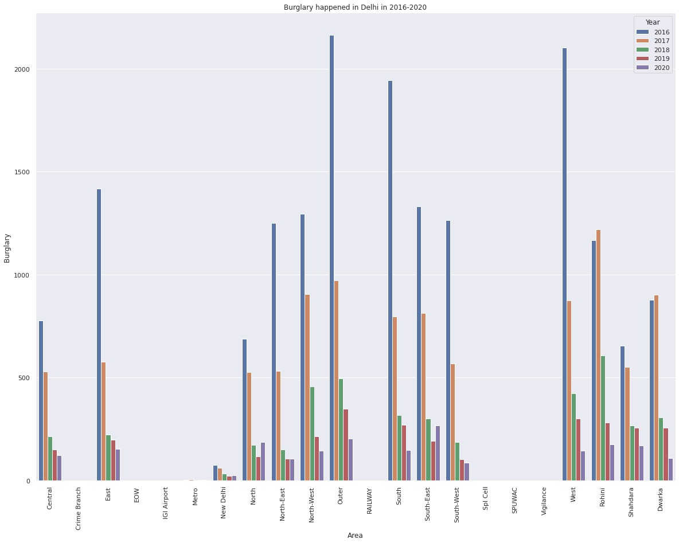
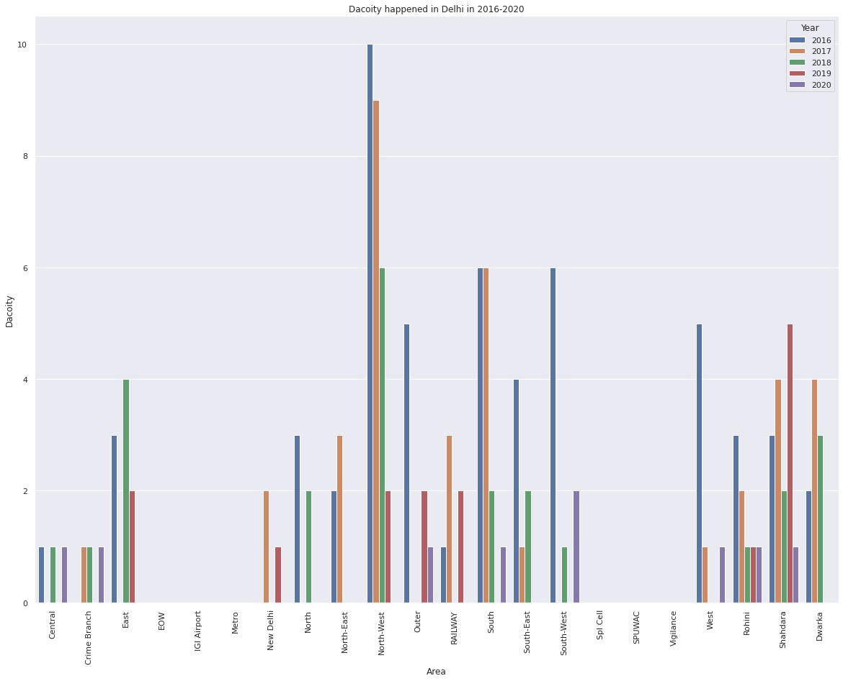
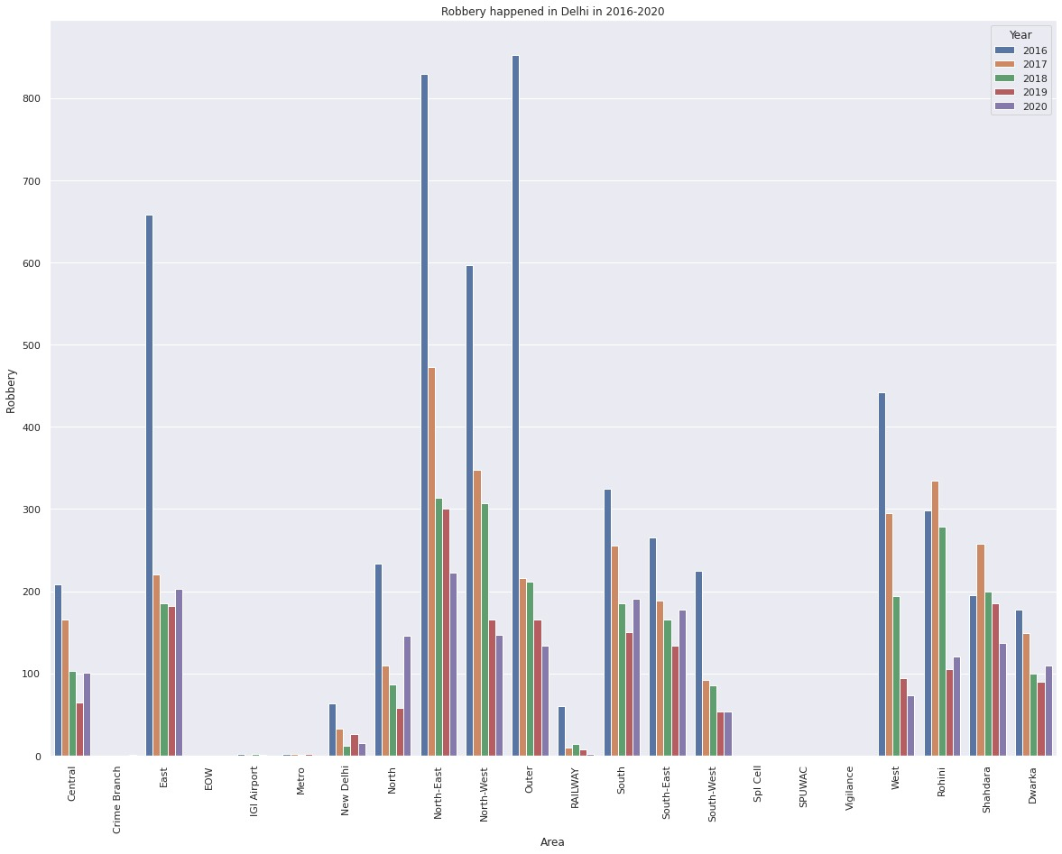
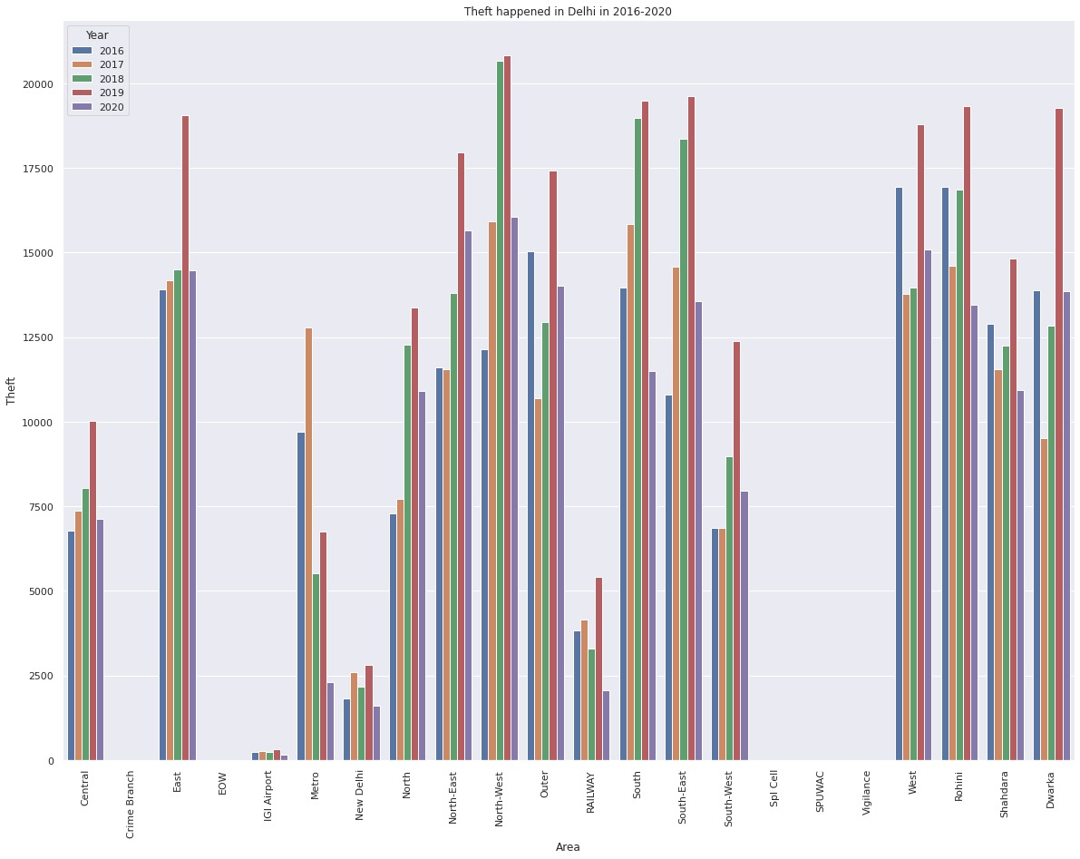
Burglary
Dacoity
Property Crime in different areas in Delhi from 2016-2020
Robbery
Theft

Slide 16

Conclusion:
Analysis for women category suggests us to have more women personnel in our police services and there should me more patrolling vans in the areas like Dwarka, East, and West districts. Also, we should have more CCTV surveillance in the areas where population is sparsely located.
Analysis of crimes against children suggests us that outer, north-east, north-west, Rohini, Dwarka are our Areas of Concerned and they need special attention to make these abodes safer for our future.
When it comes to trafficking in humans, Delhi allows us to be hopeful as we have seen a decline in the cases in last six years, still we need to have an attentive eye on Central , North-East, North-west areas.
Further analysis of homicides in Delhi city compels us to take all the districts evenly under the umbrella as the district wise analysis shows very slight differences in the cases whether the location is sparsely populated or congested. Overall number of homicides in last 6 years is 2491 which is scary.
In the last category we Analyzed that in the areas which are heavily populated thefts are more prevalent while which are sparsely populated, robbery, burglary and dacoity are more prevalent. All we can suggest with this is "Take Care of Your Wallet".

Slide 17

Thank You

